Slide 1

Thymeleaf & Controllers
Thymeleaf Helpers, Validators
SoftUni Team
Technical Trainers
Software University
http://softuni.bg

Slide 2
Table of Contents
Thymeleaf Helpers
Dates
Strings
Numbers
Aggregates
Validations

Slide 3
Have a Question?
sli.do #java-web

Slide 4
Advanced Thymeleaf
Helpers

Slide 5




Helpers
Objects that provide built-in functionalities that helps you enhance your view
Dates
Strings
List
Thymeleaf
Numbers

Slide 6
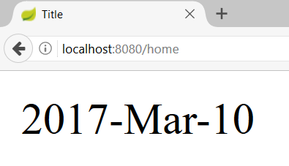
Date – Custom Format
WhiskeyController.java
@GetMapping("/home")
public String getHomePage(Model model){
model.addAttribute("myDate", new Date());
return "whiskey-home";
}
Format Date
whiskey-home.html
<div th:text="${#dates.format(myDate,'yyyy-MMM-dd')}"></div>

Slide 7
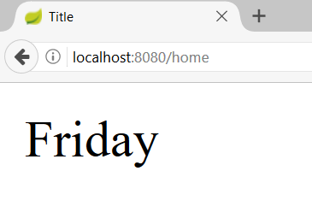
Date – Week Name of Day
WhiskeyController.java
@GetMapping("/home")
public String getHomePage(Model model){
model.addAttribute("myDate", new Date());
return "whiskey-home";
}
Day Name
whiskey-home.html
<div th:text="${#dates.dayOfWeekName(myDate)}"></div>

Slide 8
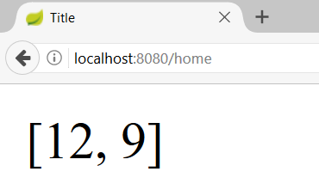
Date – List Days
WhiskeyController.java
@GetMapping("/home")
public String getHomePage(Model model){
model.addAttribute("myDates", myDates); //2016-12-12, 2017-04-09 -> yyyy-MM-dd
return "whiskey-home";
}
List Days
whiskey-home.html
<div th:text="${#dates.listDay(myDates)}"></div>

Slide 9
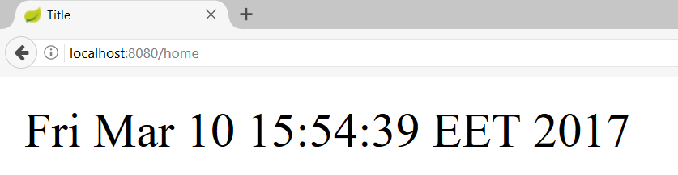
Date – Get Current Date
WhiskeyController.java
@GetMapping("/home")
public String getHomePage() {
return "whiskey-home";
}
Today’s Date
whiskey-home.html
<div th:text="${#dates.createNow()}"></div>

Slide 10
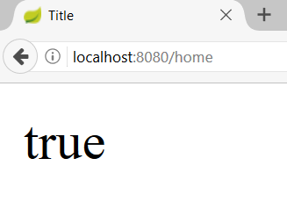
Strings – Is Empty
WhiskeyController.java
@GetMapping("/home")
public String getHomePage(Model model) {
String whiskeyNull = null;
model.addAttribute("whiskey", whiskeyNull);
return "whiskey-home";
}
Null/Empty Check
whiskey-home.html
<div th:text="${#strings.isEmpty(whiskey)}"></div>

Slide 11
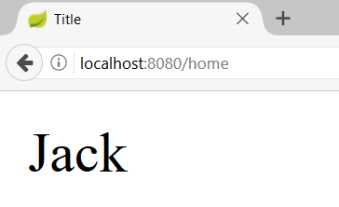
Strings – Substring
WhiskeyController.java
@GetMapping("/home")
public String getHomePage(Model model) {
String whiskey = "Jack Daniels";
model.addAttribute("whiskey", whiskey);
return "whiskey-home";
}
Substring
whiskey-home.html
<div th:text="${#strings.substring(whiskey,0,4)}"></div>

Slide 12
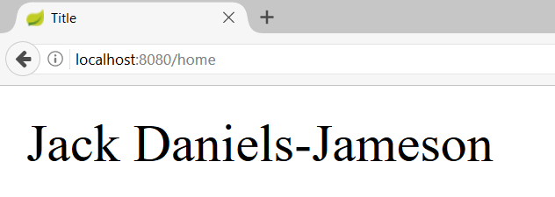
Strings – Join
WhiskeyController.java
@GetMapping("/home")
public String getHomePage(Model model) {
model.addAttribute("whiskeys", whiskeys);
// Jack Daniels, Jameson
return "whiskey-home";
}
Join
whiskey-home.html
<div th:text="${#strings.listJoin(whiskeys,'-')}"></div>

Slide 13
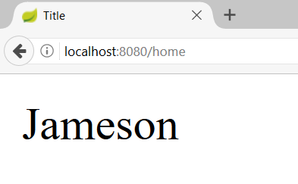
Strings – Capitalize
WhiskeyController.java
@GetMapping("/home")
public String getHomePage(Model model) {
String whiskey = “jameson";
model.addAttribute("whiskey", whiskey);
return "whiskey-home";
}
Capitalize
whiskey-home.html
<div th:text="${#strings.capitalize(whiskey)}"></div>

Slide 14
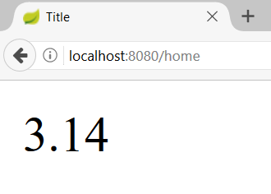
Numbers - Format
WhiskeyController.java
@GetMapping("/home")
public String getHomePage(Model model) {
double num = 3.14159;
model.addAttribute("num", num);
return "whiskey-home";
}
Format
whiskey-home.html
<div th:text="${#numbers.formatDecimal(num,1,2)}"></div>

Slide 15
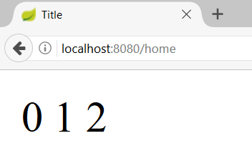
Numbers - Sequence
WhiskeyController.java
@GetMapping("/home")
public String getHomePage(Model model) {
return "whiskey-home";
}
Sequence
whiskey-home.html
<span th:each="number: ${#numbers.sequence(0,2)}">
<span th:text="${number}"></span>
</span>

Slide 16
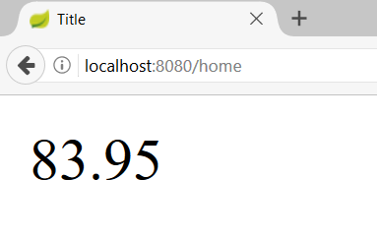
Aggregates - Sum
WhiskeyController.java
@GetMapping("/home")
public String getHomePage(Model model) {
double[] whiskeyPrices = new double[]{29.23, 21.22,33.50};
model.addAttribute("whiskeyPrices",whiskeyPrices);
return "whiskey-home";
}
Sum
whiskey-home.html
<div th:text="${#aggregates.sum(whiskeyPrices)}

Slide 17
Thymeleaf in JavaScript
JSController.java
@GetMapping("/js")
public String getMapPage(Model model){
String message = "Hi JS!";
model.addAttribute("message", message);
return "page";
}
script.js
<script th:inline="javascript">
var message = [[${message}]]; <script>

Slide 18

How to validate?
Implementing simple Error rendering

Slide 19
Spring Validation & Thymeleaf
Making a simple Model validation and Error rendering
SomeModel.java
Error Message
public class SomeModel {
@NotNull
@Size(min = 3, max = 10, message = "Invalid name")
private String name;
}
Not Null
Size
SomeController.java
Sending a model to the view
@Controller
public class SomeController {
@GetMapping("/add")
public String getPage
(@ModelAttribute SomeModel someModel) {
return "add";
}
}

Slide 20
Spring Validation & Thymeleaf
Making a simple Model validation and Error rendering
SomeController.java
@PostMapping("/add")
public String add (@Valid @ModelAttribute SomeModel someModel, BindingResult bindingResult) {
if(bindingResult.hasErrors()){
return "add";
}
this.someService.save(someModel);
return "redirect:/home";
}
Validate the model
Validation Result

Slide 21
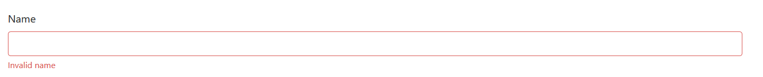
Spring Validation & Thymeleaf
Making a simple Model validation and Error rendering
Get Object
add.html
Append Class
<form method="post" th:object="${someModel}">
<div class="form-group" th:classappend="${#fields.hasErrors('name')}? 'has-danger'">
<label for="nameId">Name</label>
<input type="text" th:field="*{name}"/>
<small id="nameHelp"
th:each="error : ${#fields.errors('name')}" th:text="${error}“
Error Message
</small>
</div>
</form>
Access Field
Render Error

Slide 22
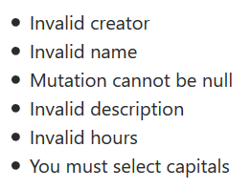
List All Errors
add.html
<ul th:if="${#fields.hasErrors('*')}">
<li th:each="err : ${#fields.errors('*')}" th:text="${err}">
Input is incorrect
</li>
</ul>
add.html
<ul th:if="${#fields.hasErrors('${someModel.*}')}">
<li th:each="err : ${#fields.errors('${someModel.*}')}" th:text="${err}">
Input is incorrect
</li>
</ul>

Slide 23
Custom Annotations (1)
You can also implement custom validation annotations
Sometimes it is necessary due to complex validation functionality
PresentOrFuture.java
@Retention(RetentionPolicy.RUNTIME)
@Target(ElementType.FIELD)
@Constraint(validatedBy = PresentOrFutureValidator.class)
public @interface PresentOrFuture {
String message() default "Invalid Date";
Class<?>[] groups() default {};
Class<? extends Payload>[] payload() default {};
}

Slide 24
Custom Annotations (2)
You will have to implement a custom validator too
Annotation
add.html
public class PresentOrFutureValidator implements ConstraintValidator<PresentOrFuture, Date> {
@Override
public boolean isValid(Date date,
ConstraintValidatorContext constraintValidatorContext) {
Date today = new Date();
return date.after(today);
}
}
Field Type
True = No Error; False = Error

Slide 25


Summary
Objects that provide built-in functionalities that helps you enhance your view
Thymeleaf provides helpers and validations
Making a simple Model validation and Error rendering

Slide 26
https://softuni.bg/trainings/courses

Slide 27













SoftUni Diamond Partners

Slide 28





SoftUni Organizational Partners

Slide 29




Trainings @ Software University (SoftUni)
Software University – High-Quality Education and Employment Opportunities
softuni.bg
Software University Foundation
http://softuni.foundation/
Software University @ Facebook
facebook.com/SoftwareUniversity
Software University Forums
forum.softuni.bg

Slide 30

License
This course (slides, examples, demos, videos, homework, etc.) is licensed under the "Creative Commons Attribution-NonCommercial-ShareAlike 4.0 International" license

